Slide 1

U9/10 Session Plan
Passing and Receiving

Slide 2
Session Structure & Overview
Structure of Session
Arrival Games: 10 Mins
FUNctional Activity: 15 Mins
Skill Game: 15 Mins
Final Game: 20 Mins
Total Session Run Time: 60 Mins
People
Coaches: 1-2 Coaches
Players: 6-10 Players

Slide 3
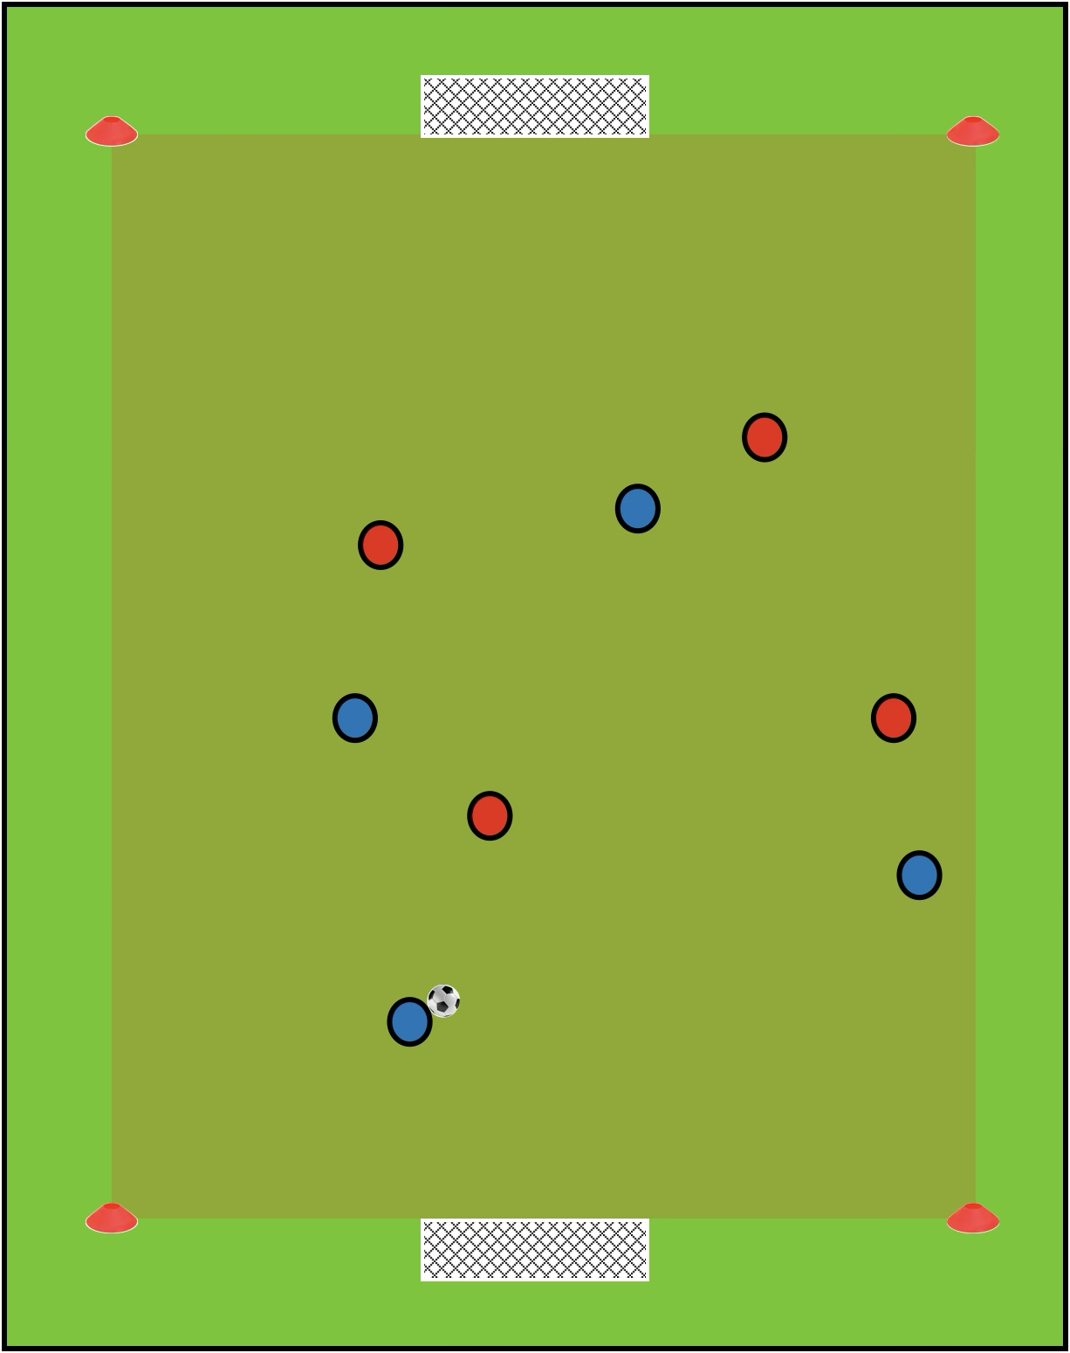
Arrival Games
Set Up
Create two small-sided games pitches, with mini goals (or cone goals) at each end
Pitch dimensions: 20-30m length x 15-20m width
Have two colours of bibs set up by each goal
Footballs are spread out around the pitch
How to Play
As players arrive, they put on a bib and jump into the game
Players can play 1v1 all the way through to 5v5
Once teams get to 5v5, players can split across the pitches
If ball goes out of play, players can restart play by dribbling or passing in from the sideline
Scoring Methods
Goals scored with a 1 touch finish are worth 3 points. All other goals are worth 1 point.

Slide 4
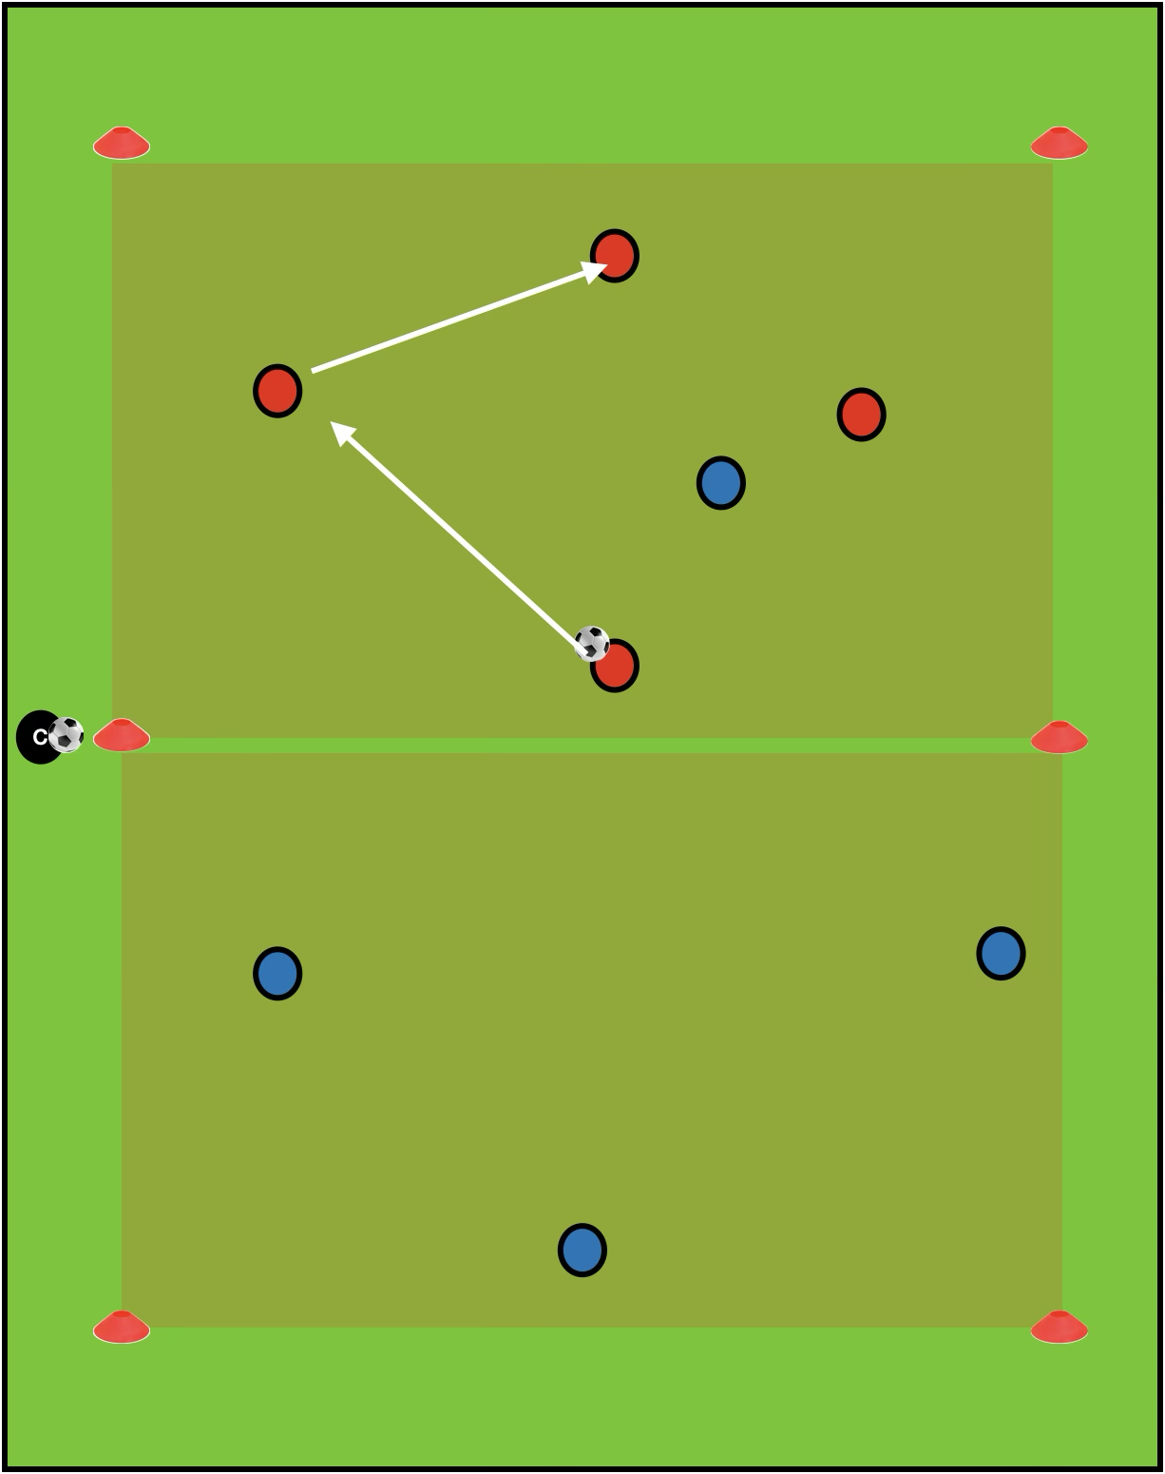
FUNctional Activity
Set Up
Pitch dimensions: 25m length x 20m width
Halfway line marked out
Players split into two even teams, each team starting on one half of the pitch
Balls start with the coach at the sideline
How to Play
Game starts with the coach passing the ball (treasure) into one team
One player from the other team (pirate) comes to try and steal the treasure
If the team with the ball kick the ball out of play, or if the pirate can steal the treasure and pass back to his team, play restarts from the opposite side
Five passes in a row = 1 point
Progress the Exercise
More Difficult: After a point is scored, an extra pirate may try to win the treasure
Make it easier: 3 passes in a row = 1 point

Slide 5
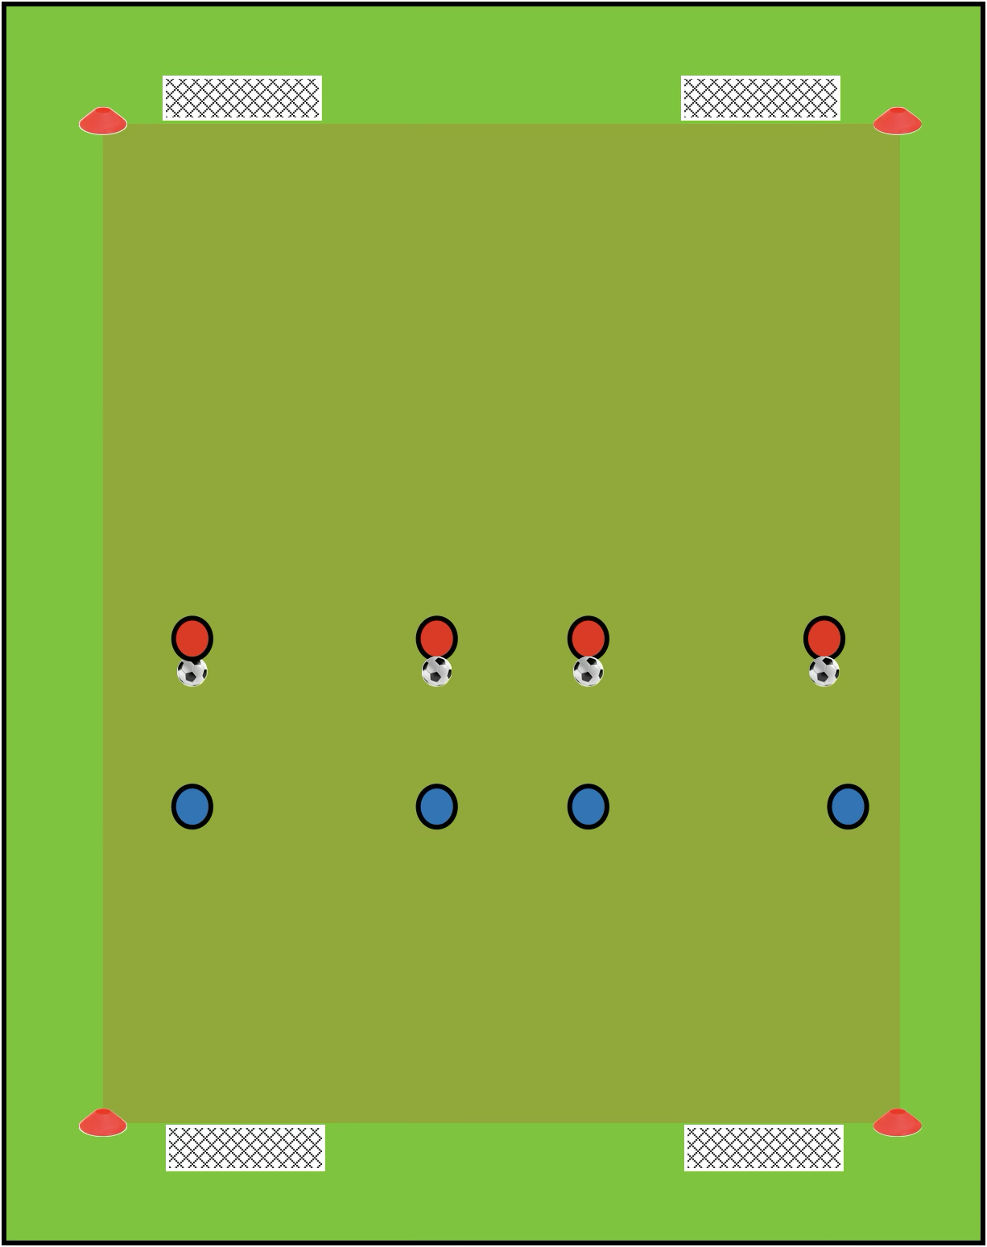
Skill Game
Set Up
Create two small-sided games pitches, with two mini goals (or cone goals) at each end
Pitch Dimensions: 30m Length x 20m Width
Players split into two even teams, each team starting on one half of the pitch
One team starts with a football each
How to Play
One team starts with a football each on the halfway line
When the game starts each player aims to score in one of the two goals by dribbling or passing through
If the defenders win the ball, they can go go score in the goals they are facing
If a ball goes out or is scored, those players can go help a teammate score/defend
Once the ball goes out of play, play resets with teams swapping attacking/defending roles
Progress The Exercise
Make it easier: all players on both teams start with a ball
Make it harder: Only 2 players start with a ball

Slide 6
Final Games
Set Up
Create two small-sided games pitches, with mini goals (or cone goals) at each end
Pitch dimensions: 20-30m length x 15-20m width
Have two colours of bibs set up by each goal
Footballs are spread out around the pitch
How to Play
Players can play 1v1 all the way through to 5v5
Once teams get to 5v5, players can split across the pitches
If ball goes out of play, players can restart play by dribbling or passing in from the sideline
Scoring Methods
Goals scored with a 1 touch finish are worth 3 points. All other goals are worth 1 point.

