Slide 1
U13-16 Session Plan
Passing and Receiving

Slide 2
Session Structure & Overview
Structure of Session
Warm Up: 10 Mins
Rondo/Passing Practice: 10-15 Mins
Positional Game: 15 Mins
Skill Game: 15-20 Mins
Final Game: 25-30 Mins
Total Session Run Time: 75-90 Mins
People
Coaches: 1-2 Coaches
Players: 12-15 Players

Slide 3
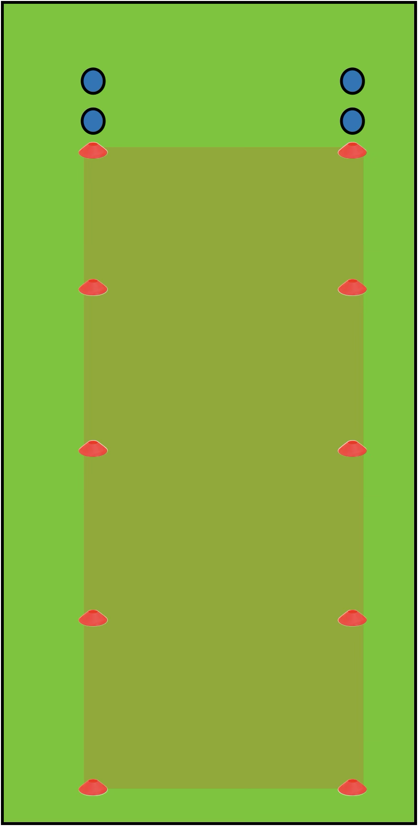
Warm Up
Set Up
Cones spaced out five metres apart for a total of 20 metres
Players lined up evenly at one end of the line
How to Play
Follow the Fifa 11+ protocol, starting with part one
Optional: complete part two (this should be done once a week)
After part two, complete part three

Slide 4
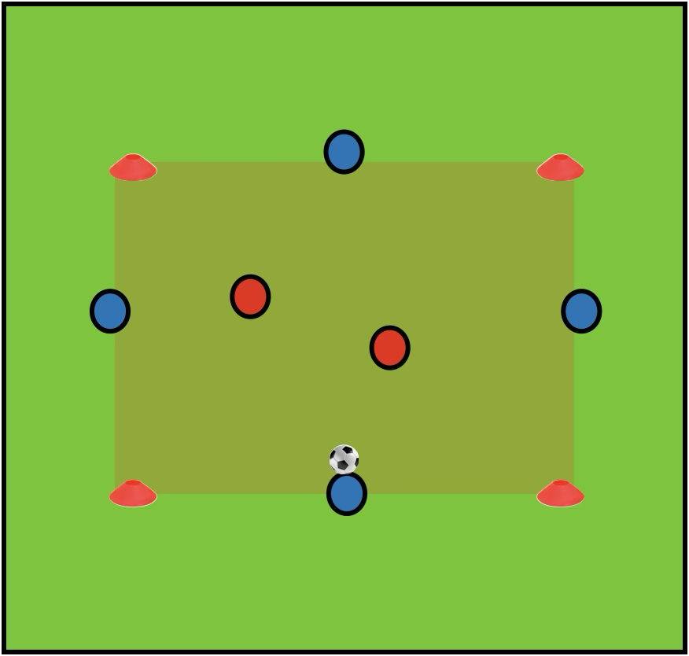
Rondos/Passing Practice
Set Up
Pitch dimensions: 6-15m width x 6-15m length, depending on player numbers
Football to the side of the square
1-3 bibs placed in the center of the square, depending on number of defenders
How to Play
This can be played with a range of players from 3v1 to 9v3
Players with the ball should be positioned around the outside of the square, defenders should hold the bibs in the middle of the square
The players with the ball aim to complete as many passes as possible, counting as they go
The defenders aim to win the ball, the defender that wins the ball swaps with the attacker that lost it
Progress the Exercise
Add rules to change the exercise
Example 1: Two touch maximum for the players on the ball
Example 2: If the players on the outside complete 10 passes, the players in the middle stay in for an extra round

Slide 5
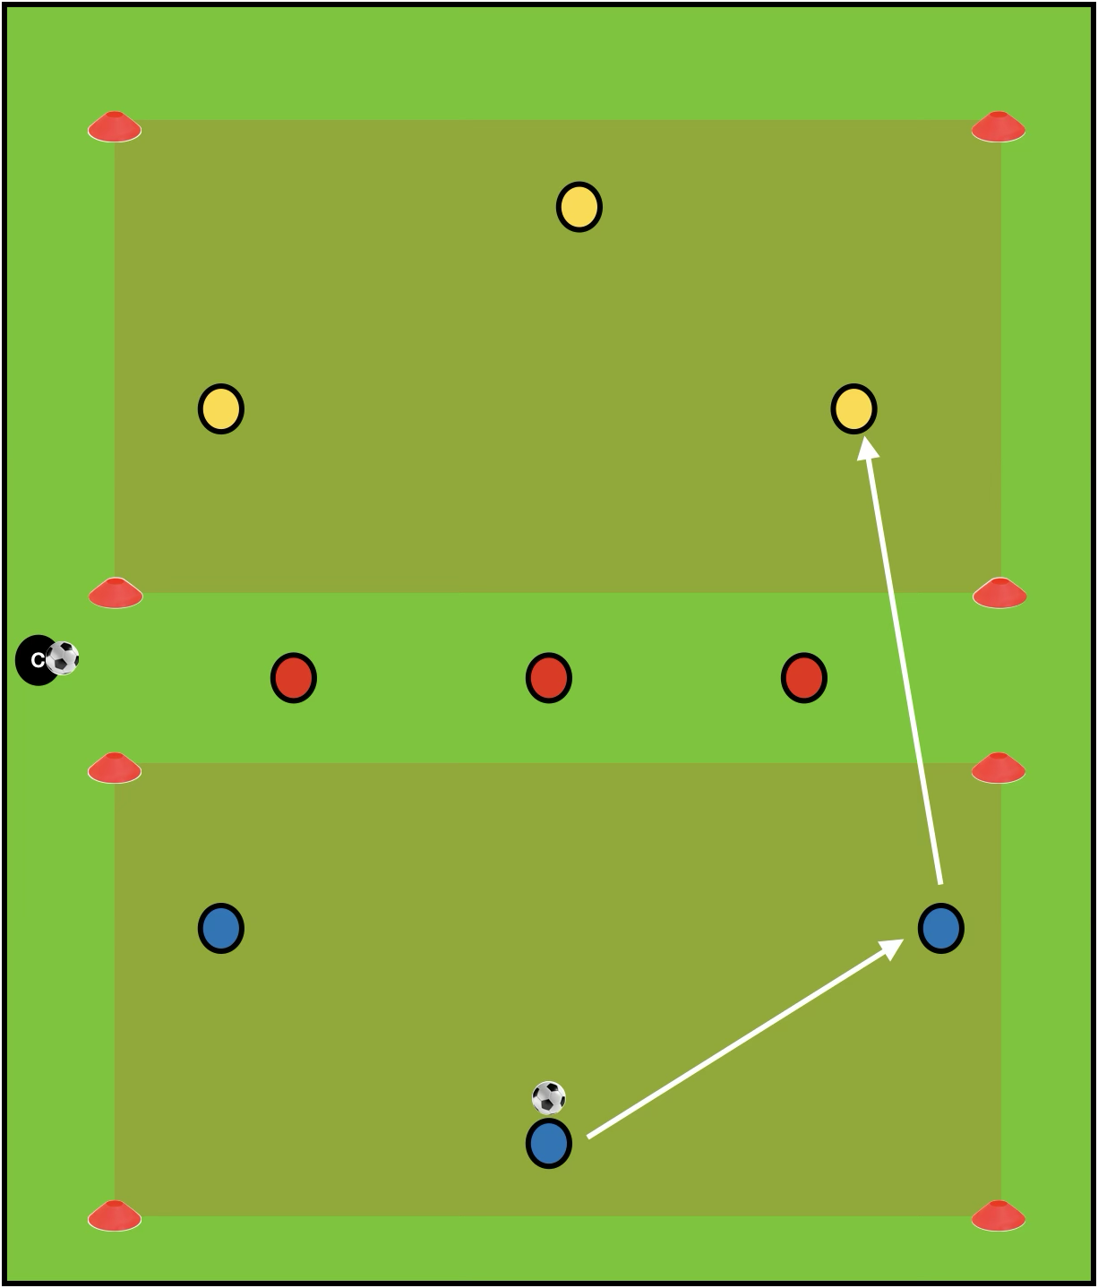
Positional Game
Set Up
Pitch dimensions: 30m length x 25m width, with an 8m channel marked out
Three even teams of players, one starting in each section off the pitch
Balls start with the coach at the sideline
How to Play
The coach serves the ball into one of the end teams (attackers)
The goal of the attackers is to complete two passes before playing across the the other end team
Passes across must be played below hip height
The central team (defenders) aims to intercept the passes through between teams
If the attackers have their pass intercepted or pass the ball out of play, they swap out with the defending team
Progress the Exercise
More Difficult: One defender can step into the attacker's square to tackle them while the other two stay in the middle zone

Slide 6
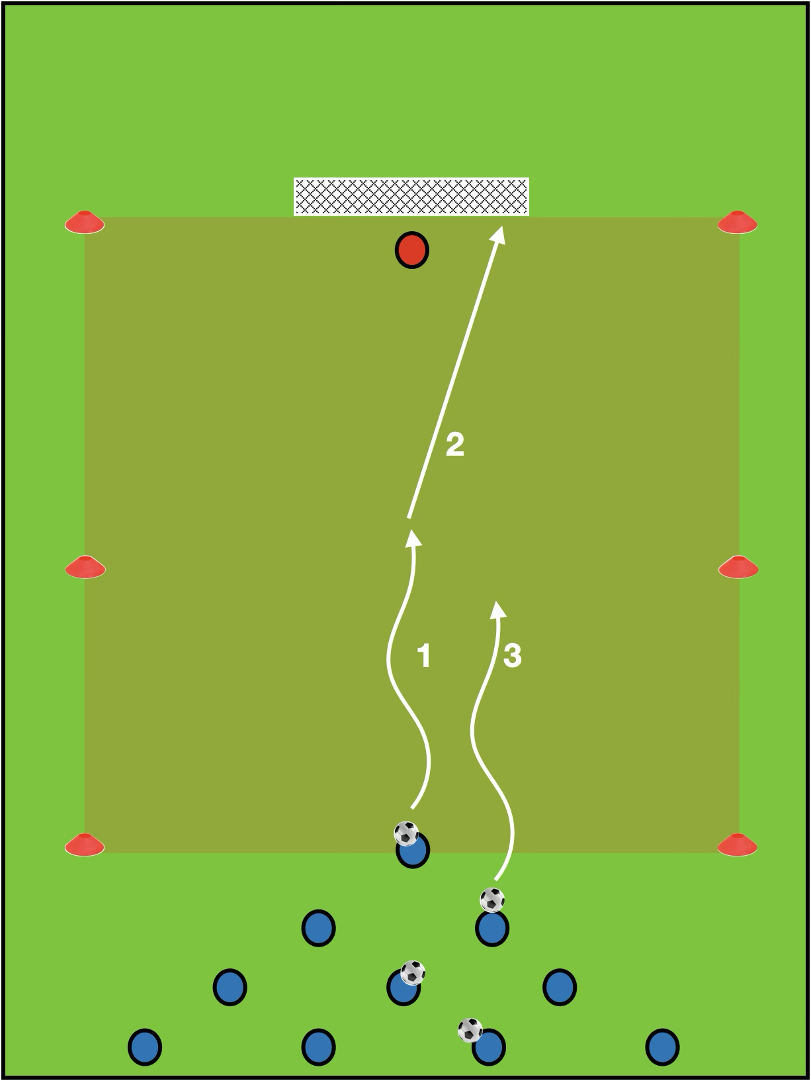
Skill Game
Set Up
Pitch Dimensions: 40m length x 25m width
Large goal placed at one end of the pitch
Players lined up in a 1-2-3-4 pyramid shape as shown
Each line of players should have a football
How to Play
The practice starts as a 1 v GK, the player must shoot before halfway
Once the ball has been shot, or goes out of play the next two players create a 2v1 against the player who has just shot
Once that ball goes out, the player who took the first shot exits the square and the next 3 players create a 3v2
This progresses to 4v3 or 5v4
Progress The Exercise
Make it easier: Adjust pyramid so there is always two players difference (2vGK, 4v2)
Make it harder: Add a time limit to each attack

Slide 7
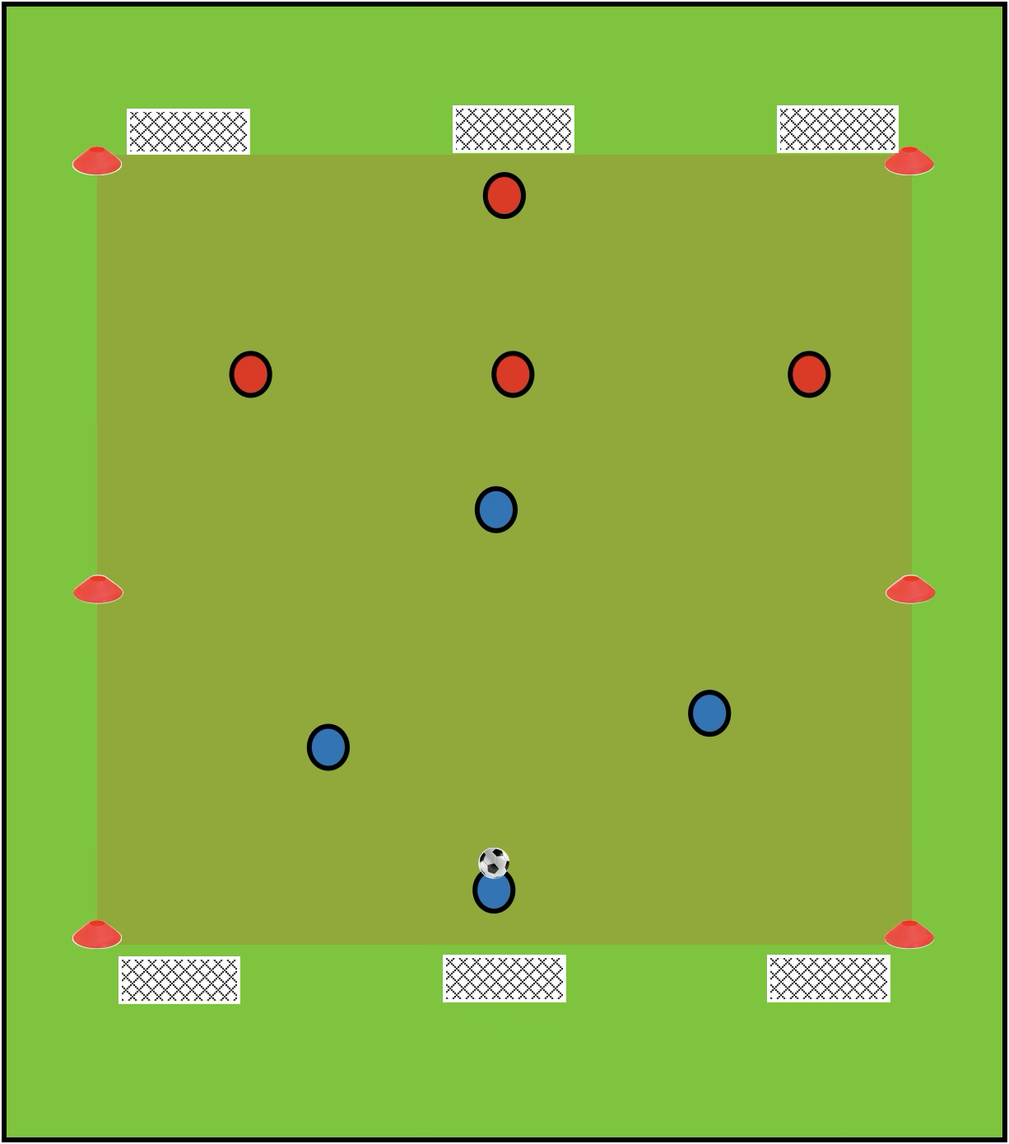
Final Games
Set Up
Create one small-sided games pitches, with three mini goals (or cone goals) at each end
Pitch dimensions: 35m length x 25m width
Players split into two even teams
Footballs are split at each end of the field
How to Play
Normal football rules apply
Players can score in any of the three goals they are attacking
If ball goes out of play, players can restart play by dribbling or passing in from their goal line
Scoring Methods
Goals scored in central goals are worth 3, while other goals are worth 1

