Slide 1
U11/12 Session Plan
1v1’s and Dribbling

Slide 2
Session Structure & Overview
Structure of Session
Arrival Games: 10 Mins
11+ Kids Activity: 0-5 Mins
FUNctional Activity: 15 Mins
Skill Game: 15-20 Mins
Final Game: 20-25 Mins
Total Session Run Time: 60-75 Mins
People
Coaches: 1-2 Coaches
Players: 8-12 Players

Slide 3
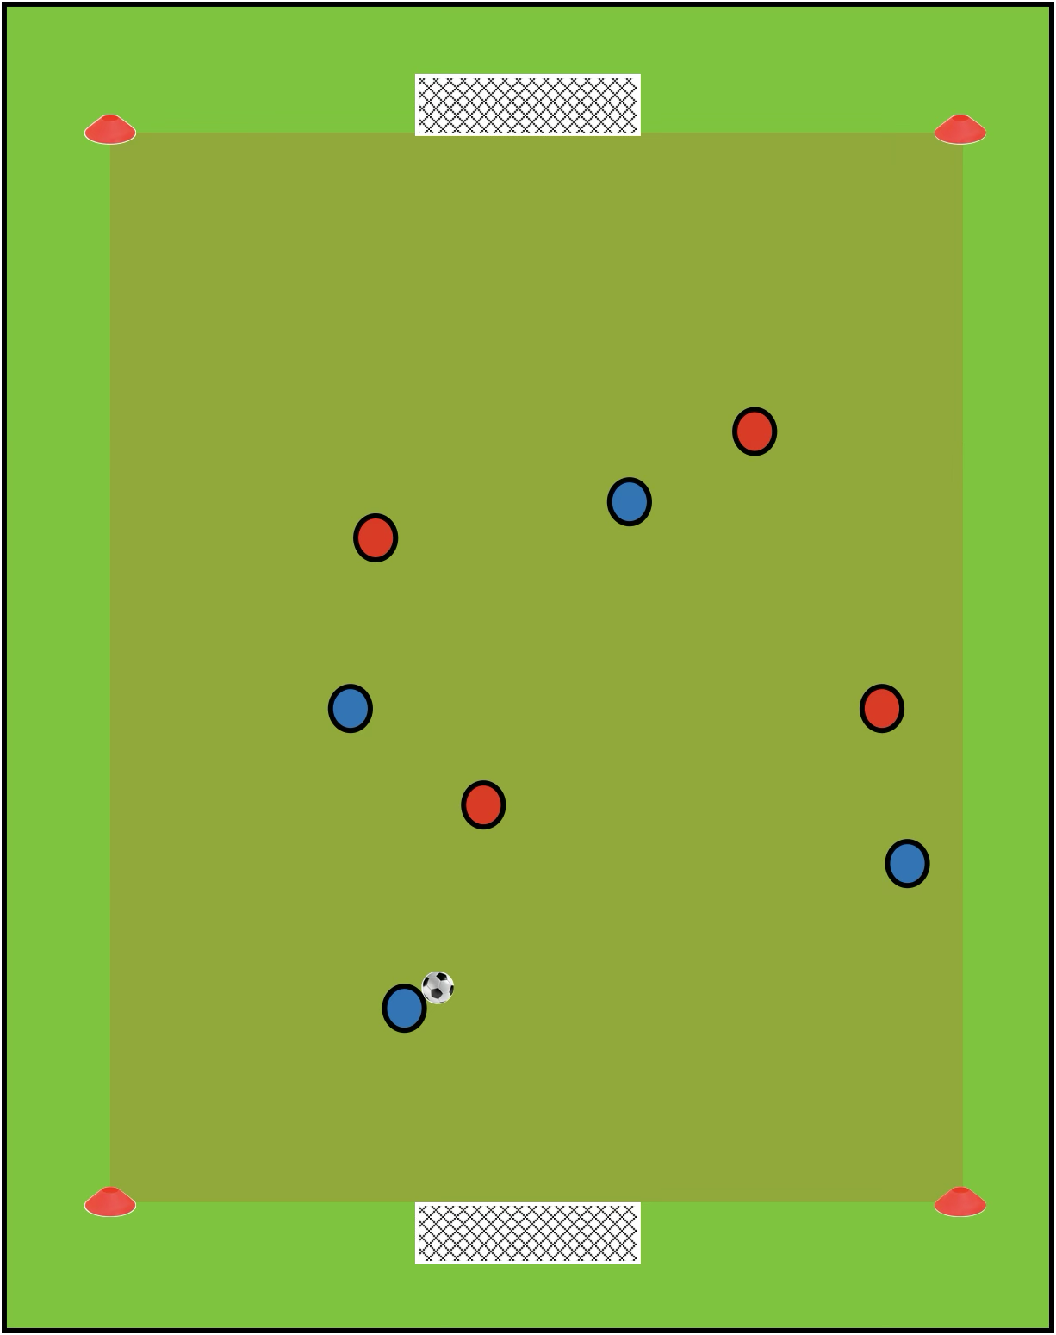
Arrival Games
Set Up
Create two small-sided games pitches, with mini goals (or cone goals) at each end
Pitch dimensions: 20-30m length x 15-20m width
Have two colours of bibs set up by each goal
Footballs are spread out around the pitch
How to Play
As players arrive, they put on a bib and jump into the game
Players can play 1v1 all the way through to 5v5
Once teams get to 5v5, players can split across the pitches
If ball goes out of play, players can restart play by dribbling or passing in from the sideline
Scoring Methods
Goals scored with a 1 touch finish are worth 3 points. All other goals are worth 1 point.

Slide 4
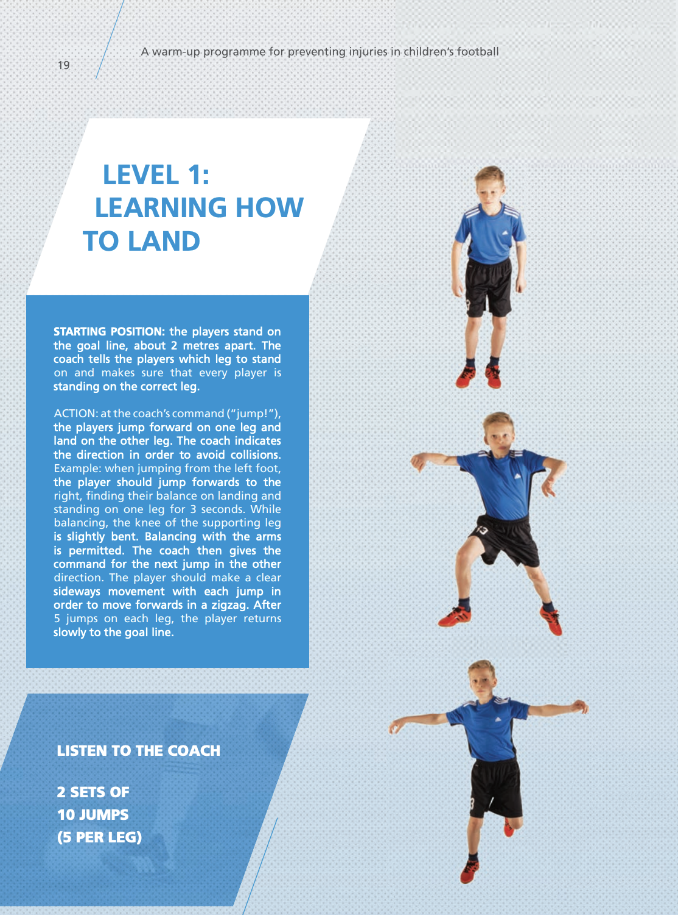
11+ Kids Activity
Set Up
No set up required at start
As players progress to later stages, one ball per player should be used
How to Play
Instructions shown in picture to the right
Progress the Exercise
There are more available levels where players can progress to once they are more confident at this level

Slide 5
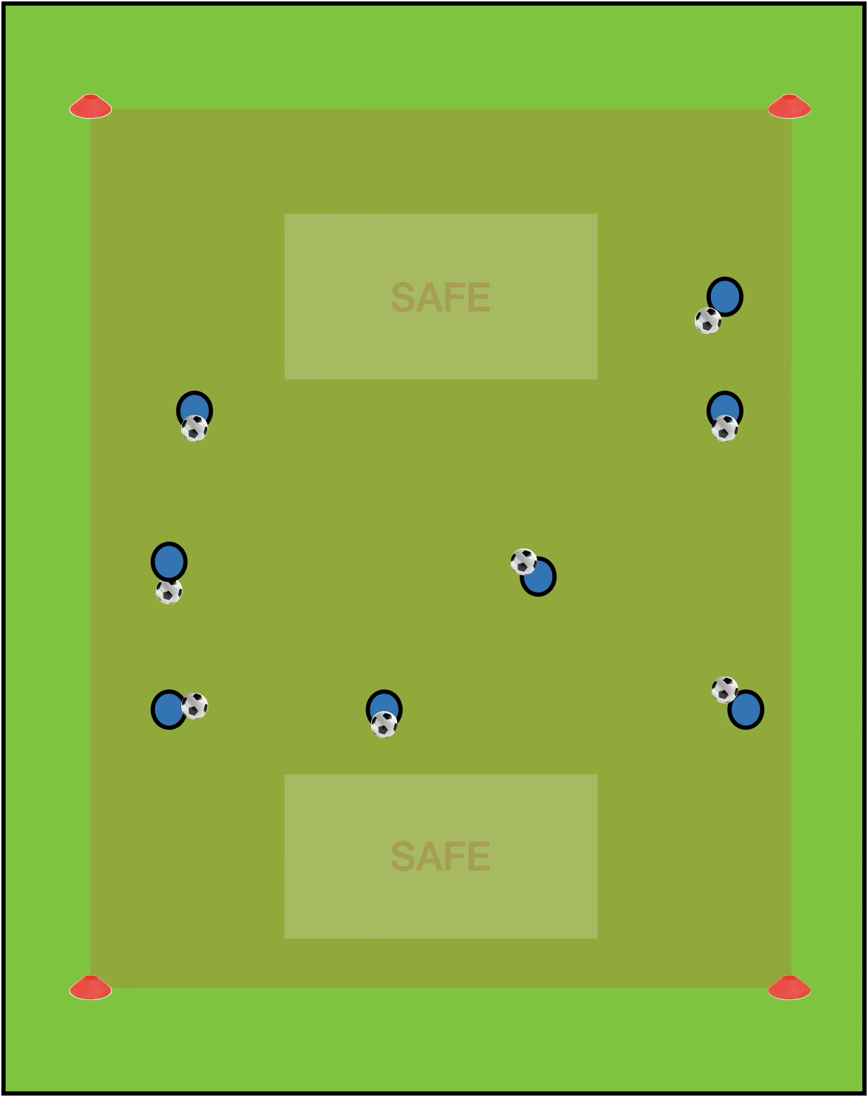
FUNctional Activity
Set Up
Pitch dimensions: 18m length x 12m width
Safe zone dimensions: 2m length x 4m width
Mark out a pitch with two safe zones anywhere on the pitch
Each player has a football
How to Play
When the coach says go, the players must dribble around in the square
Players are trying to knock other players balls out whilst protecting their own
Players may only use a safe zone once per round, when they are in the safe zone they can only be there for three seconds
If a players ball gets knocked out, they must retrieve it and dribble around two sides of the grid before re-entering the game
60 second games, players still in the square at the end of the round are the winners
Progress the Exercise
Make it harder: remove the safe zones
Make it harder: the coach may come around and knock players out aswell

Slide 6
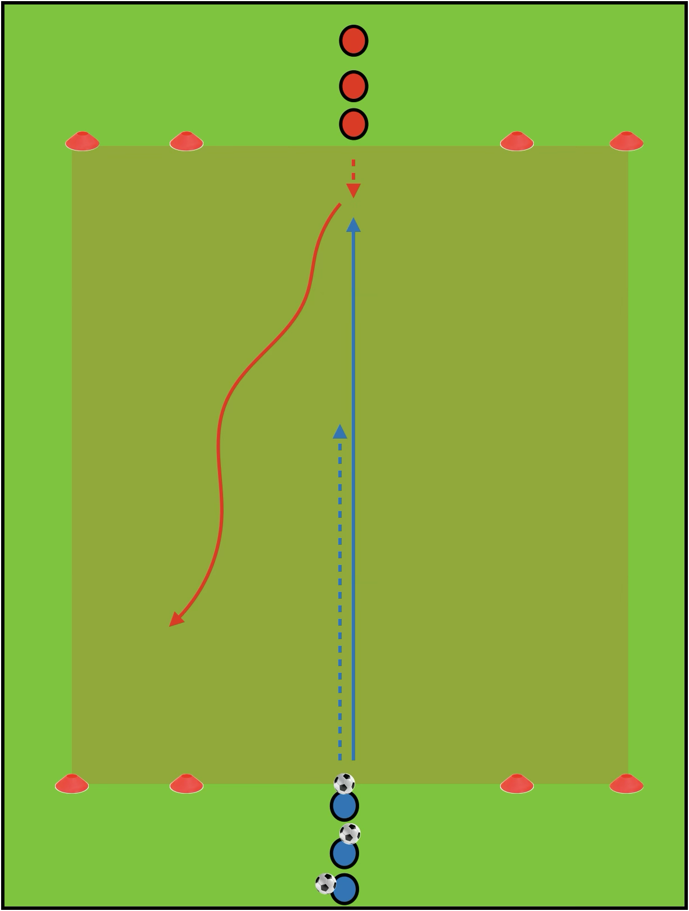
Skill Game
Set Up
Pitch Dimensions: 15m length x 10m width
2m cone goals placed in each corner
Players split into two even teams
If you have a large amount of players, you may want to set up multiple pitches
How to Play
The player at the front of the defenders line passes across to the attacker opposite him
The attacker receives the ball and aims to dribble into the two cone goals he is facing
The defender may go to press his opponent and try to win the ball off of him before scoring in the two cone goals he is facing
If the attackers score, they stay on the same sides. If not, the players swap line after each repetition
Progress The Exercise
For each repetition it is now a 2v2 with players looking to score in the same way as before

Slide 7
Final Games
Set Up
Create two small-sided games pitches, with mini goals (or cone goals) at each end
Pitch dimensions: 20-30m length x 15-20m width
Have two colours of bibs set up by each goal
Footballs are spread out around the pitch
How to Play
Players can play 1v1 all the way through to 5v5
Once teams get to 5v5, players can split across the pitches
If ball goes out of play, players can restart play by dribbling or passing in from the sideline
Scoring Methods
Goals scored with a 1 touch finish are worth 3 points. All other goals are worth 1 point.

